Slide 1
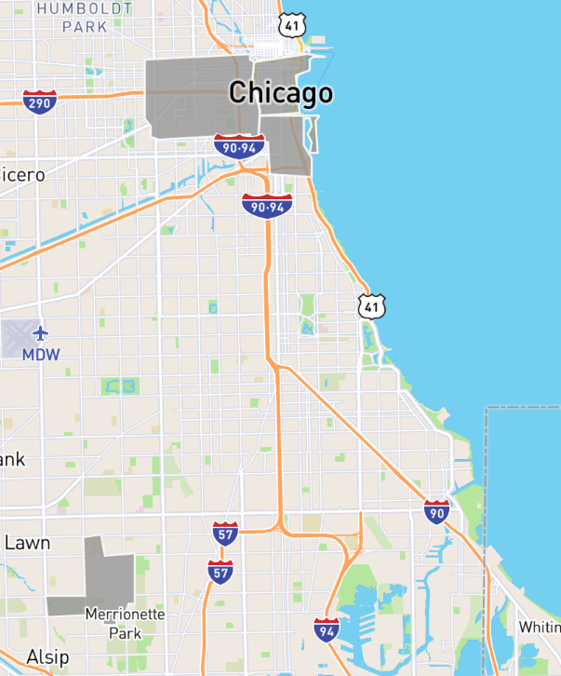
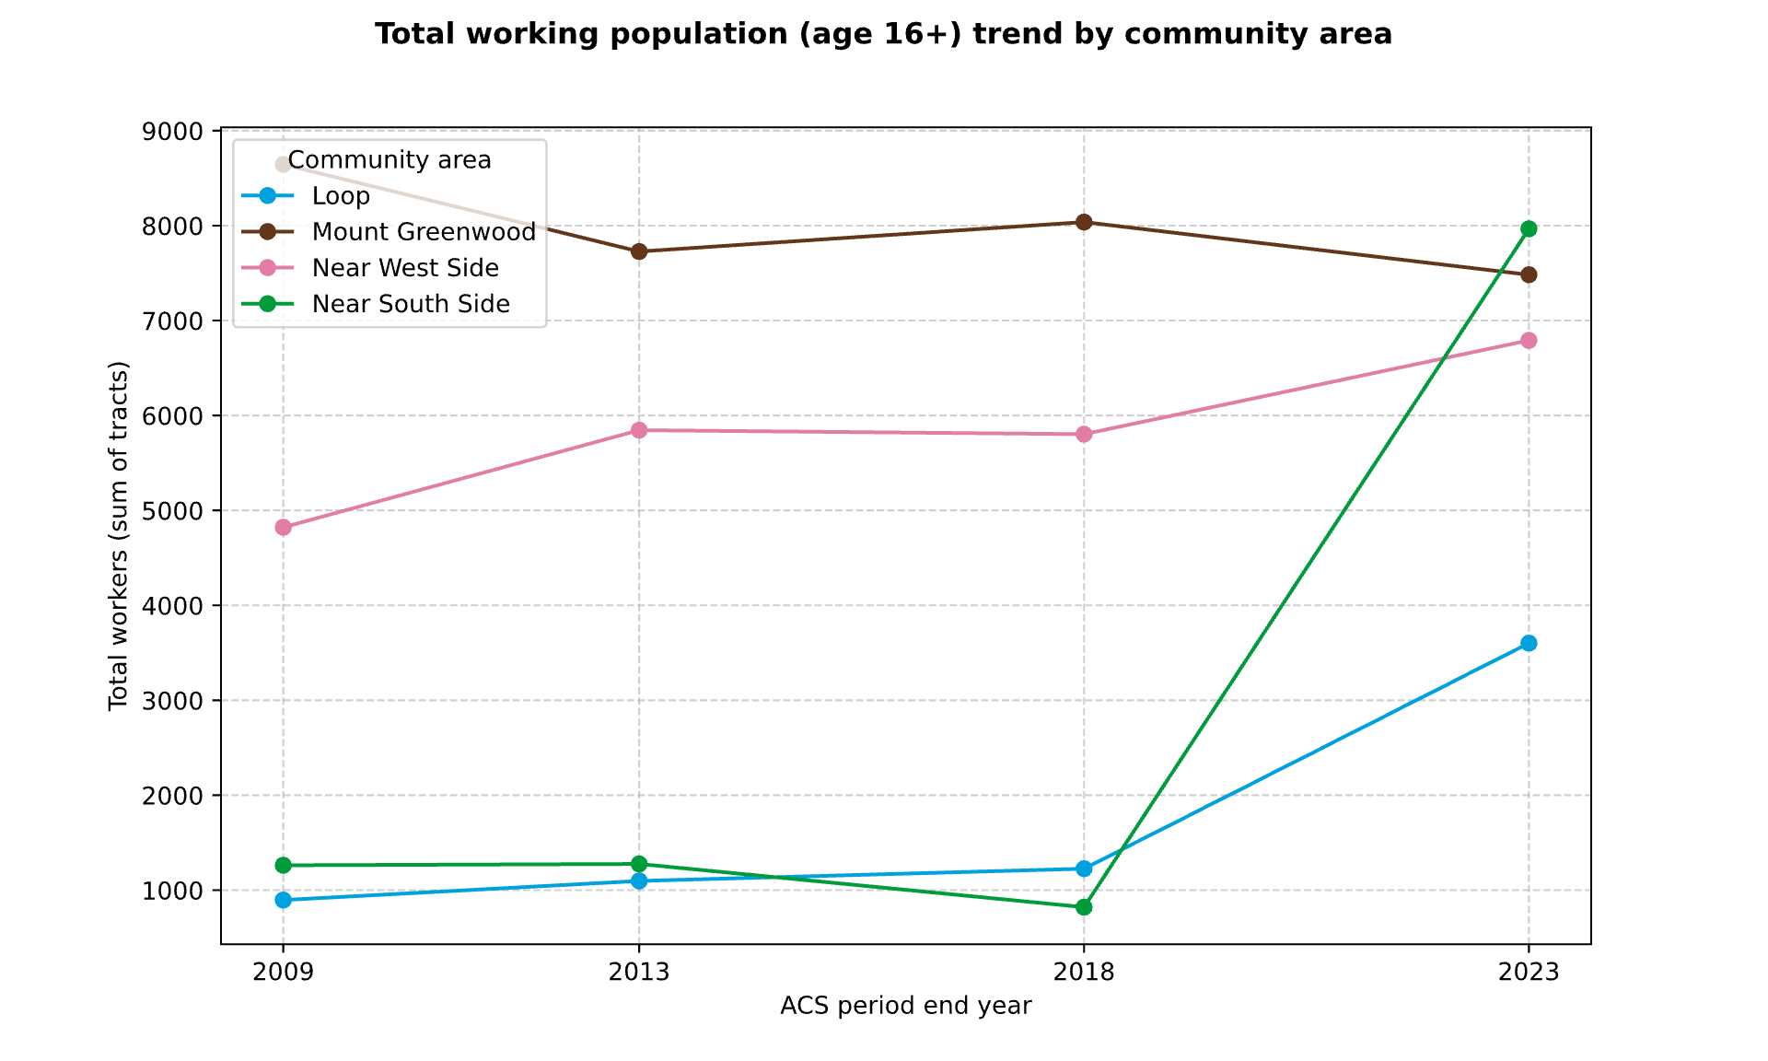
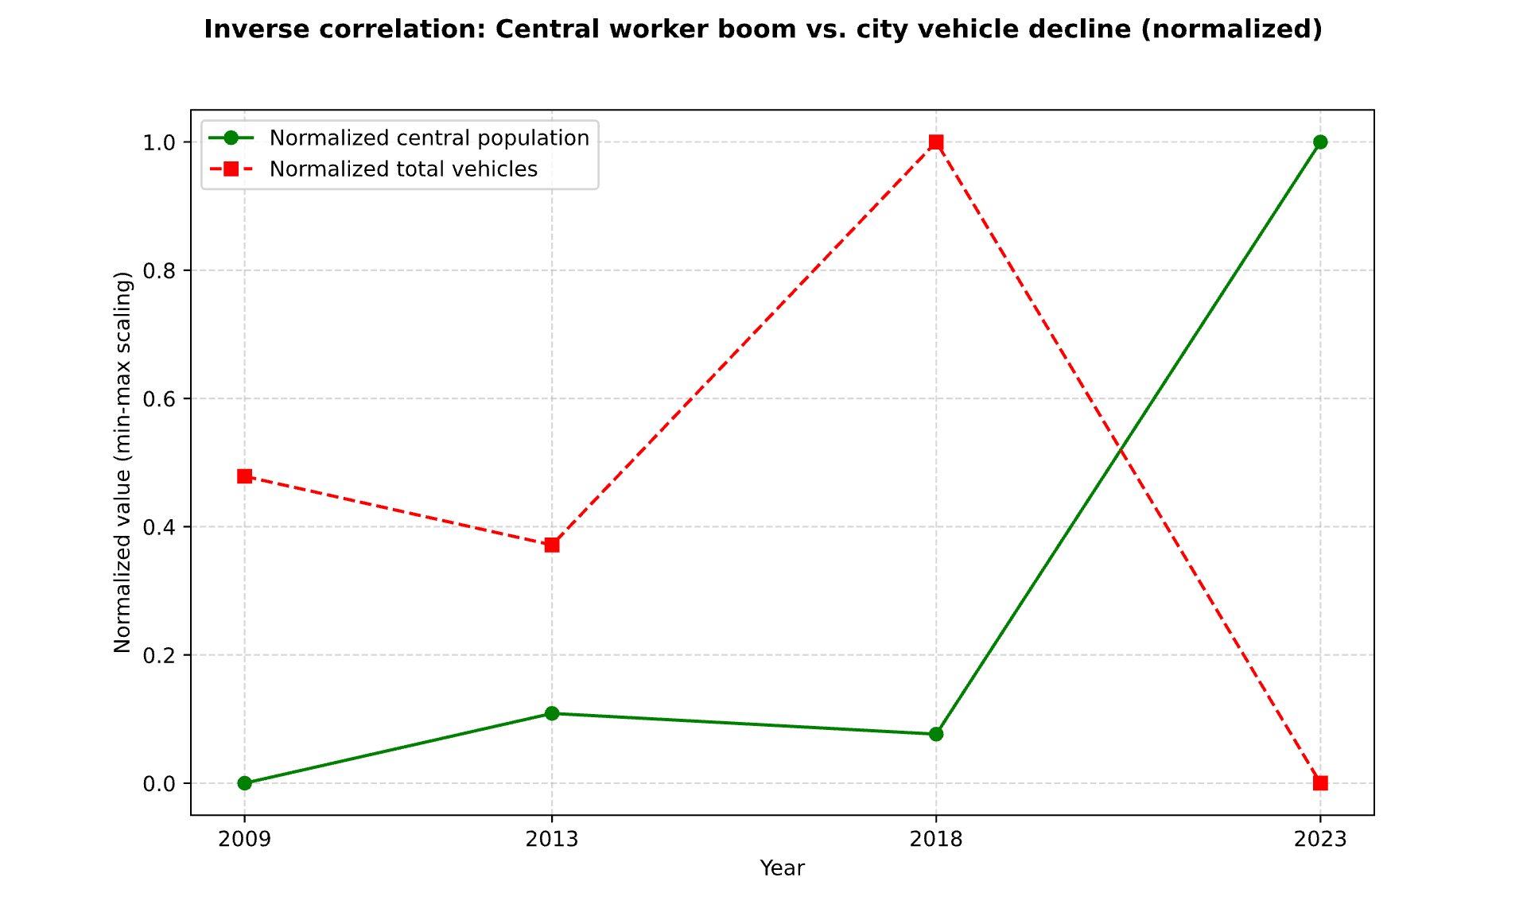
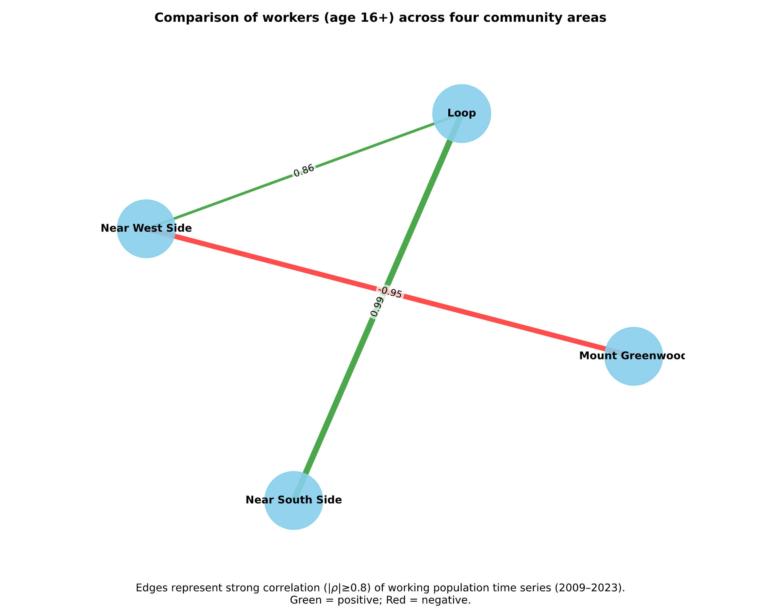
Four community areas
“L” TRAIN IMPACT ON VEHICLE OWNERSHIP by Hendra Anggrianto Wijaya (A20529195)
Loop
Near West Side
Near South Side
Selected population:
Workers with personal vehicle
Morgan
… have one new station
Selected vehicle:
Passengers only
Mount Greenwood
Cermak-McCormick Place
Washington/Wabash
… never has a station
2012
2015
2017
Result
Data sources:
Census: American Community Survey
Chicago ''L''.org
Illinois Secretary of State: Vehicle Services Statistics
Recent station openings had a modest impact from 2013 to 2018.
After COVID, ownership increased while vehicle count dropped about 10%.
The area furthest away is the only area with decreasing ownership.

